Slide 1
York Elementary School
WELCOME!
Please mute your microphone as you join the meeting.
Can’t wait to “see” you!
Virtual
Kindergarten Orientation
Thursday, May 27th at 6 PM

Slide 2
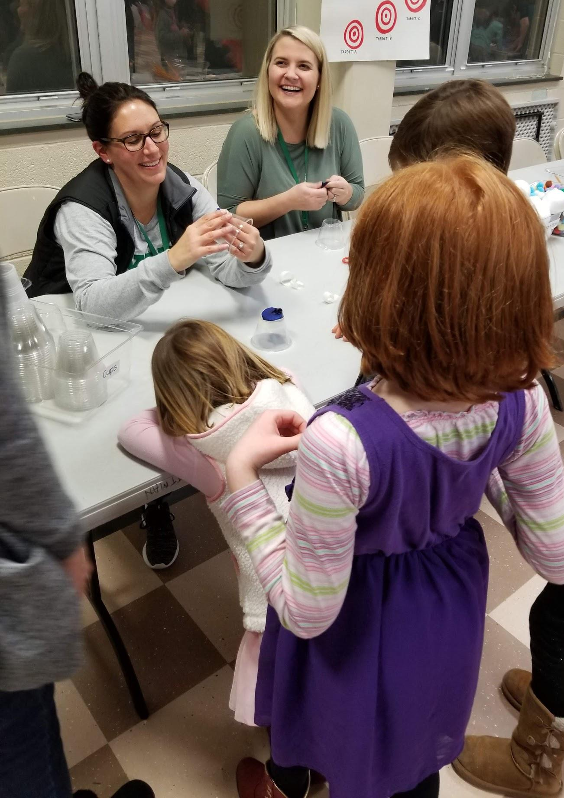
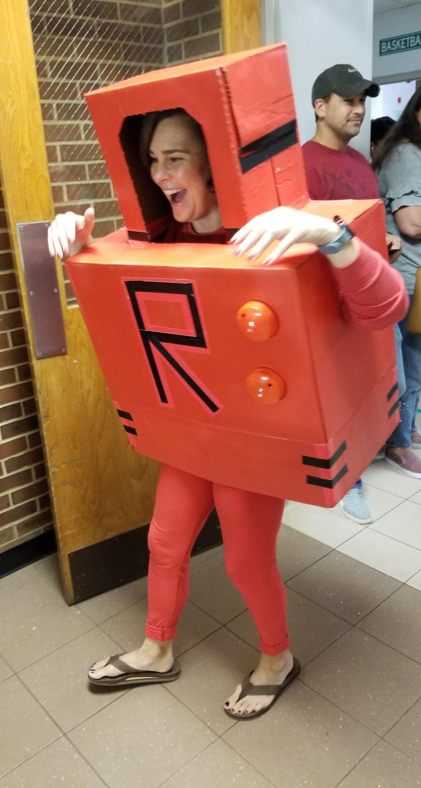
Welcome to the York Family!
Notes:
We are excited to meet your rising kindergarten student and welcome you to the YES family!
Due to COVID-19 we were unable to have our in-person kindergarten orientation, so we’re moving forward with a virtual orientation.
Please review the information in this presentation to learn more about your student’s kindergarten year.
The dates for all the events listed in this presentation will be released & posted to our website calendar.

Slide 3
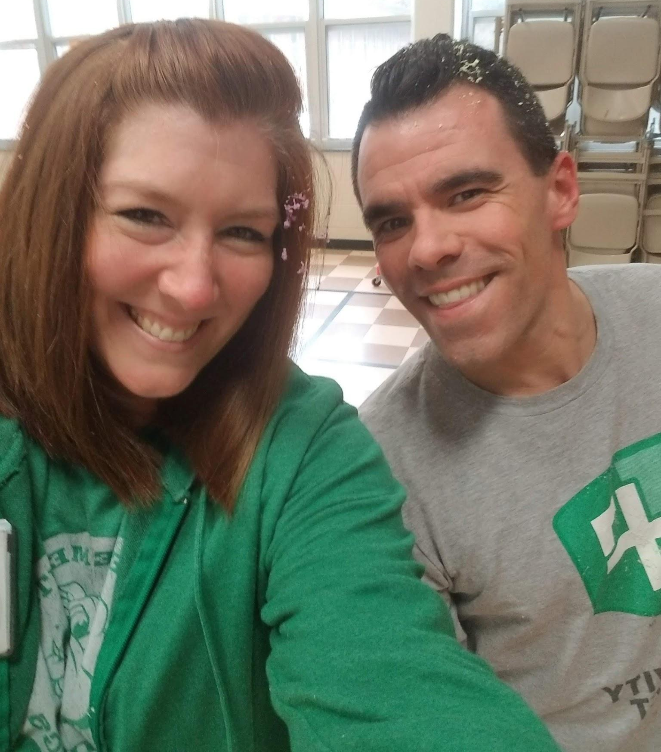
York Administration
Kate Williams, Principal
kwilliams3@wcpss.net
Tim Huber, Assistant Principal
thuber@wcpss.net

Slide 4
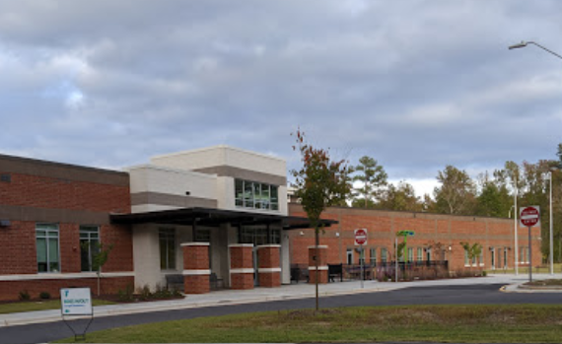
Our location for the 2020-2021 school year...
York’s former campus is currently under construction for the 2020-2021 school year.
We have moved to our swing space at 12004 Strickland Drive, Raleigh, NC 27613
Summer office hours are Tuesday/Thursday from 9:00am - 3:00 pm.
If you need to come to campus, please call first or email as we may be able to save you a trip.
School colors: Kelly Green & White
Mascot: English Bulldog

Slide 5
School Operations:
Our school day starts at 9:15am with arrival running from 8:45-9:10am.
Dismissal is at 3:45pm. Typically most bus departures and carpool pick ups are finished by 4:15 pm.
YMCA will provide before school care. York staff will provide after school care for families for the 2021-22 school year.
If you are interested in after school care, please fill out this form: https://forms.gle/57YdwVeuYusAjrUj7
Breakfast and lunch will be FREE for all students during the 2021-2022 school year.
If you need to apply for Free or Reduced lunch, applications are available online through My School Apps and on the WCPSS Website.

Slide 6
STEM School of Distinction
York was designated a NC STEM School of Distinction in 2017 and again in 2020!
*Follows a 3 year cycle in NC.
York embodies STEM from its Vision & culture at school down to the core curriculum taught.
We use the Engineering Design Process (EDP) to problem solve.
Students will engage in STEM virtually or in person.
*Please start collecting recyclables and create a STEM box for your house!

Slide 7
School Wide STEM Challenges
Our Current STEM Challenge (K-5):
“The Little Red Fort”
Inspired by the book…
Questions contact:
Ms. O. (AKA Coach O.)
mosterhoff@wcpss.net
Notes:
Links to the STEM project are on the picture and title of the project. http://detectiveosterhoff.weebly.com/
mosterhoff@wcpss.net

Slide 8
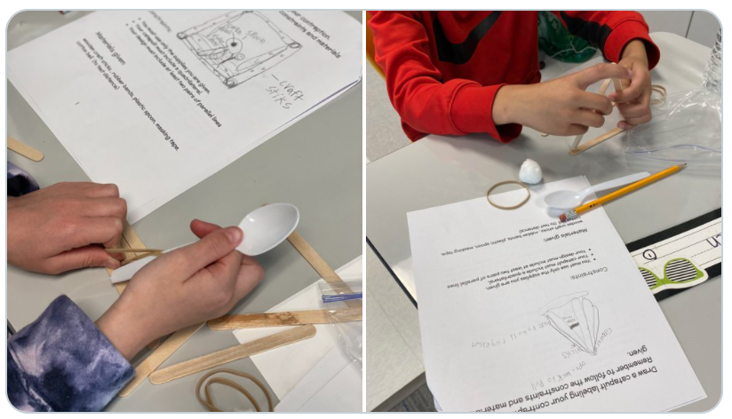
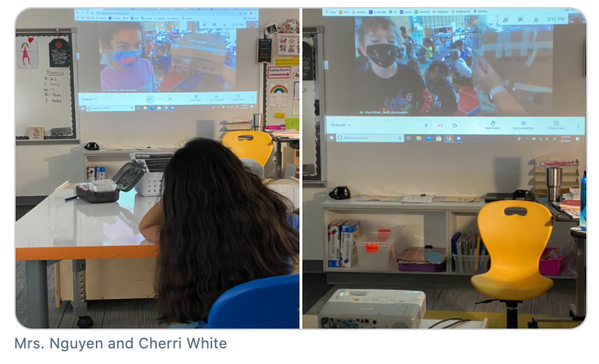
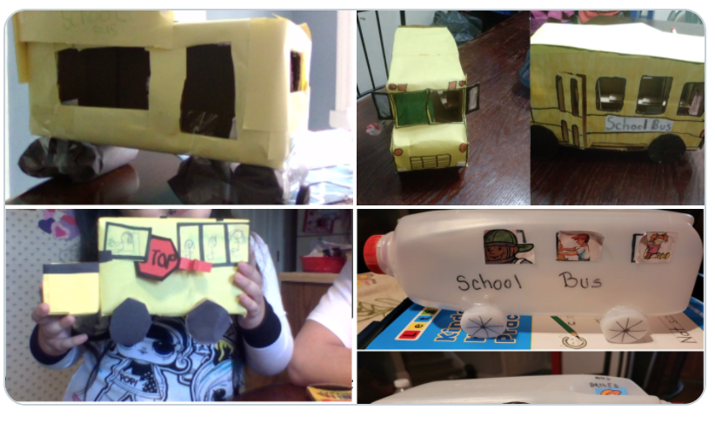
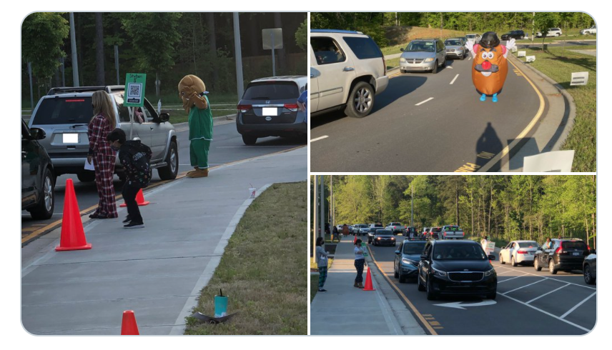
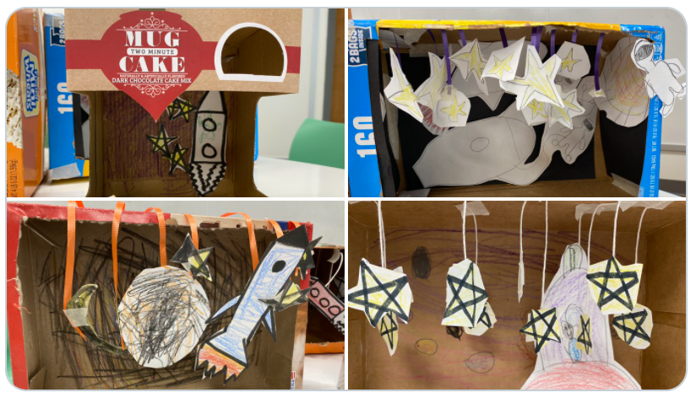
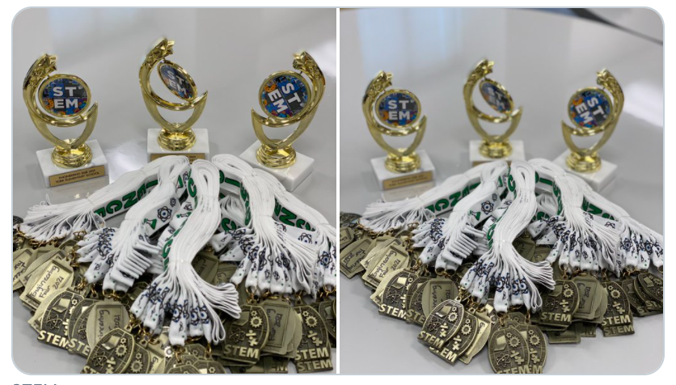
STEM In Action!
Just a few of the many tweets and pictures of STEM at our school.

Slide 9
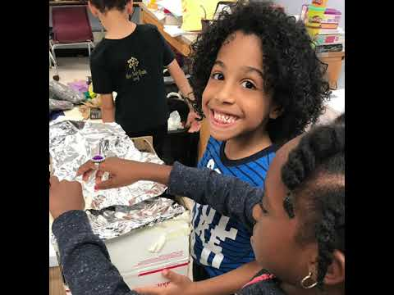
A glimpse into York...

Slide 10
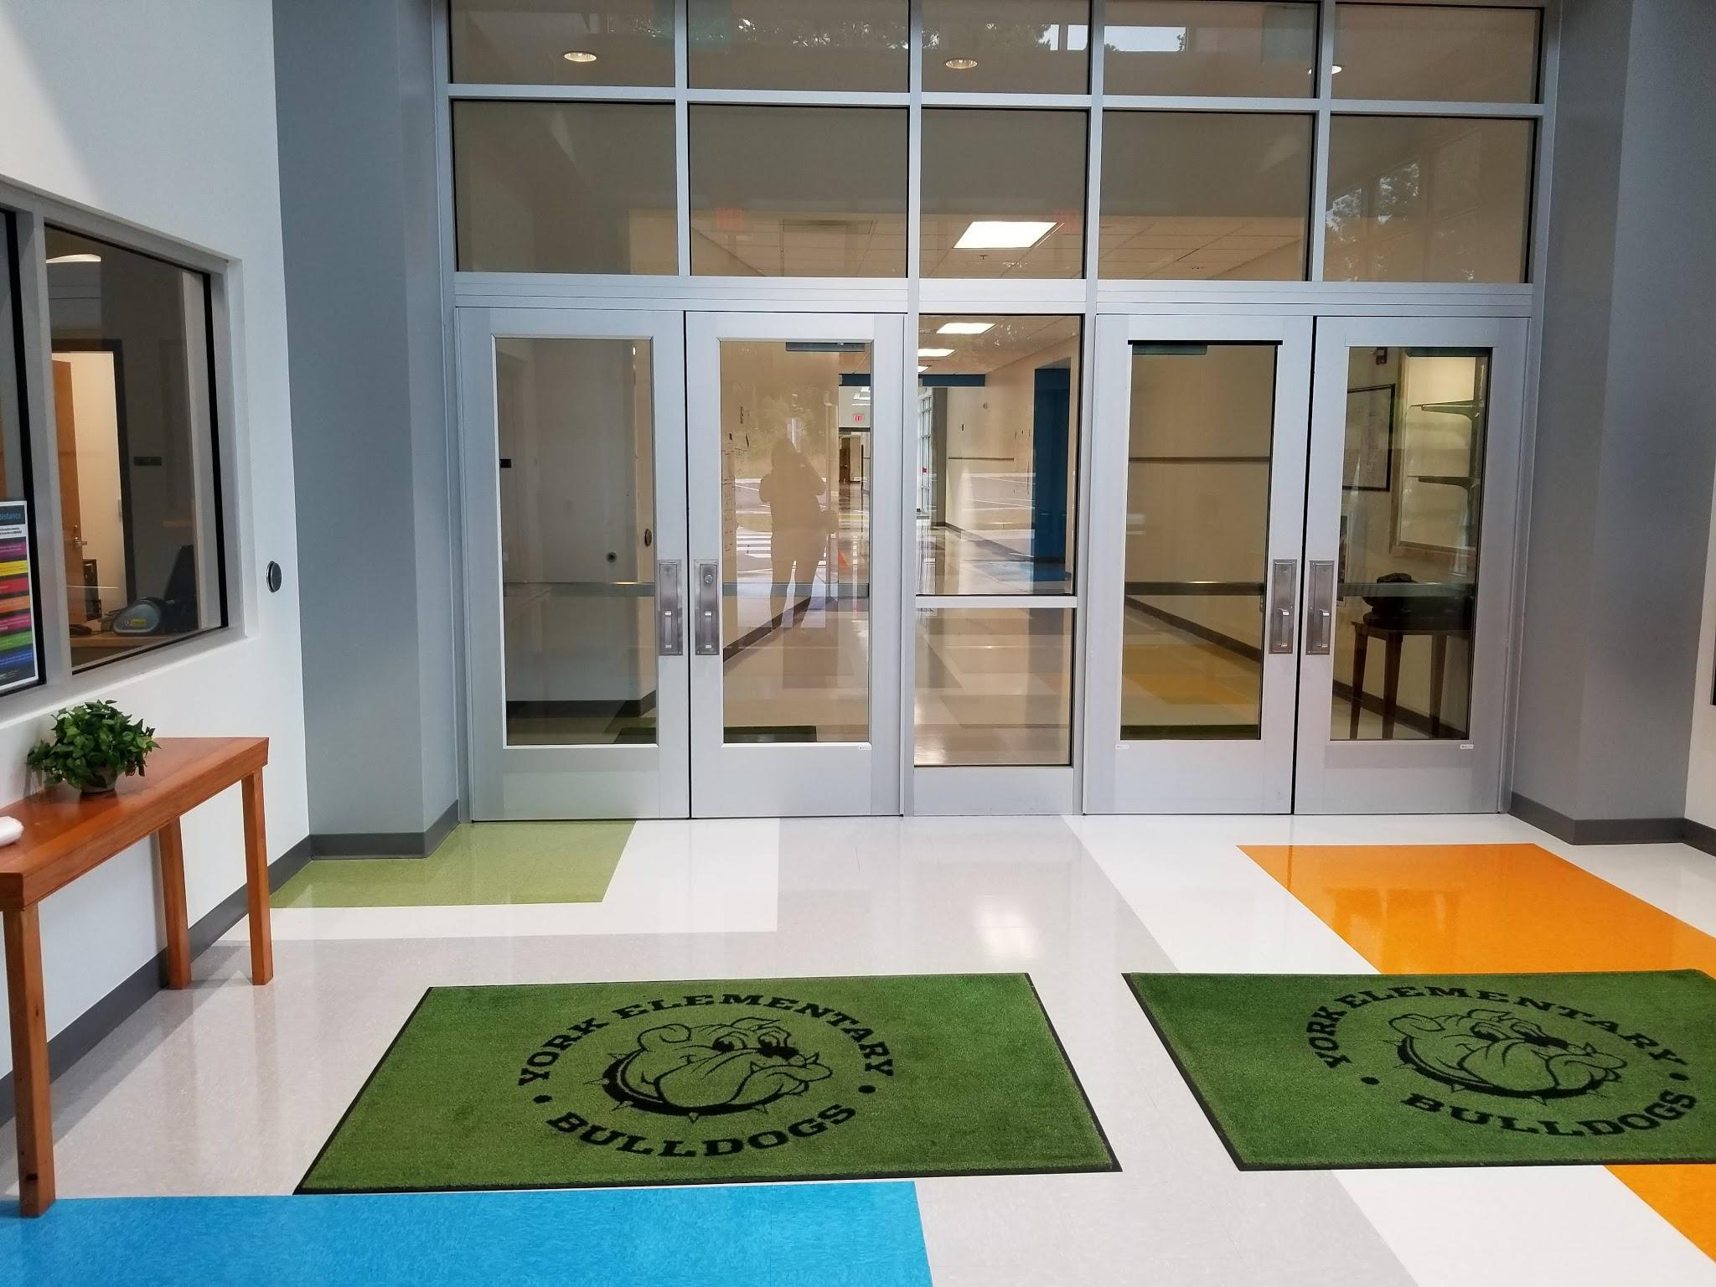
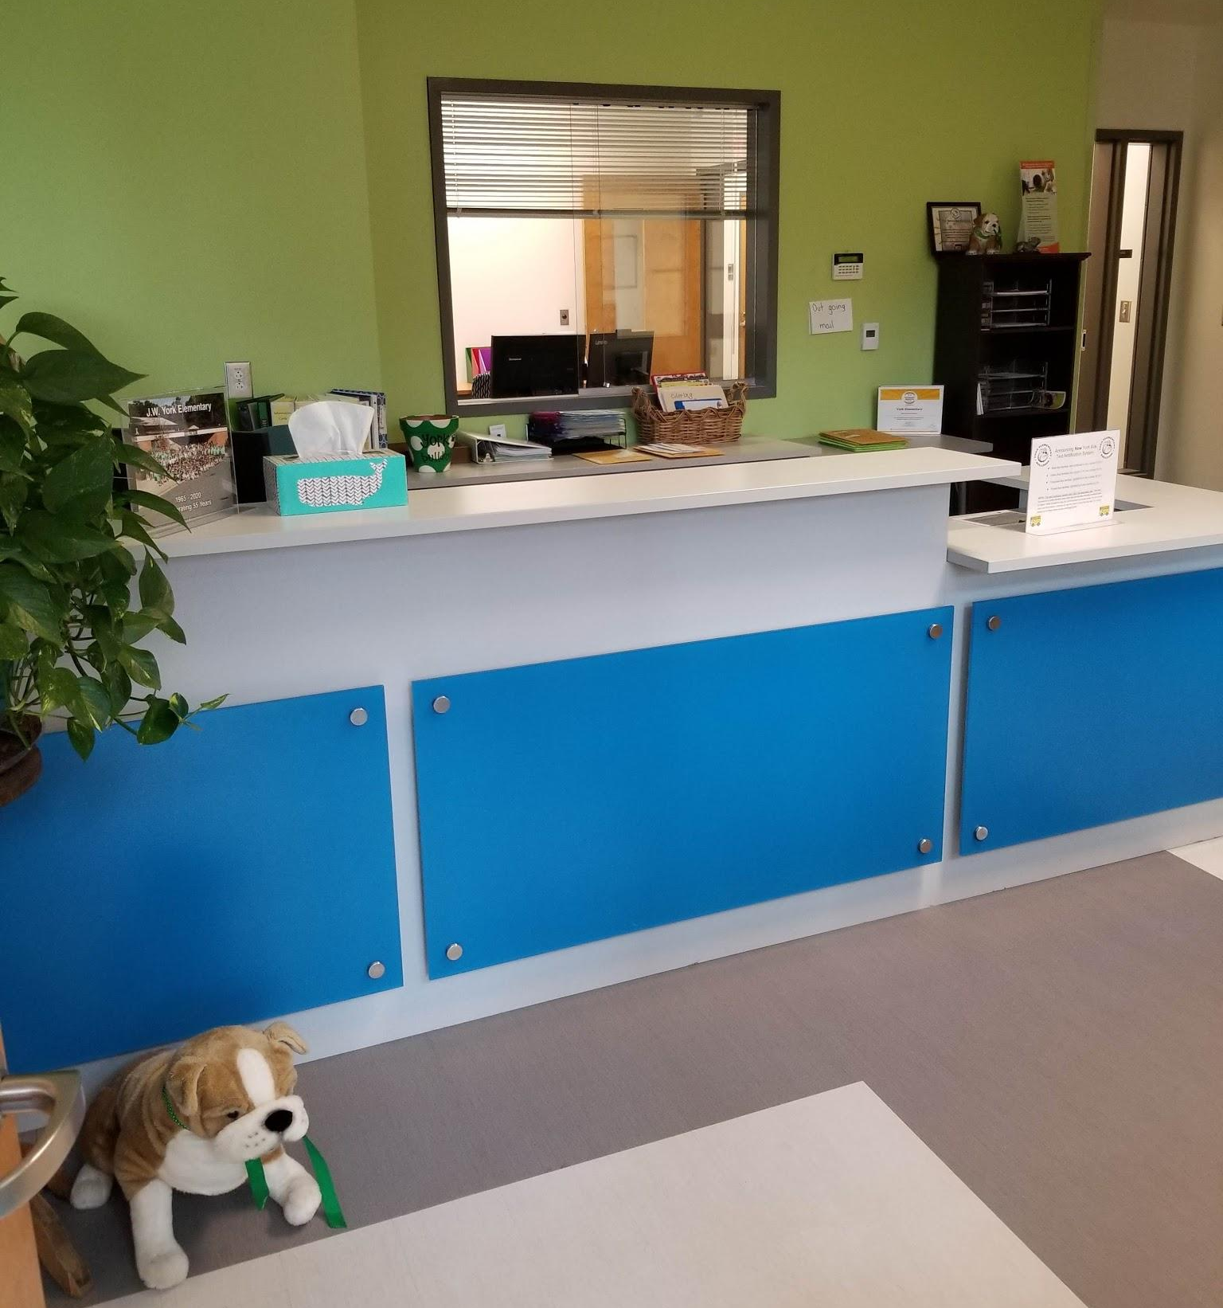
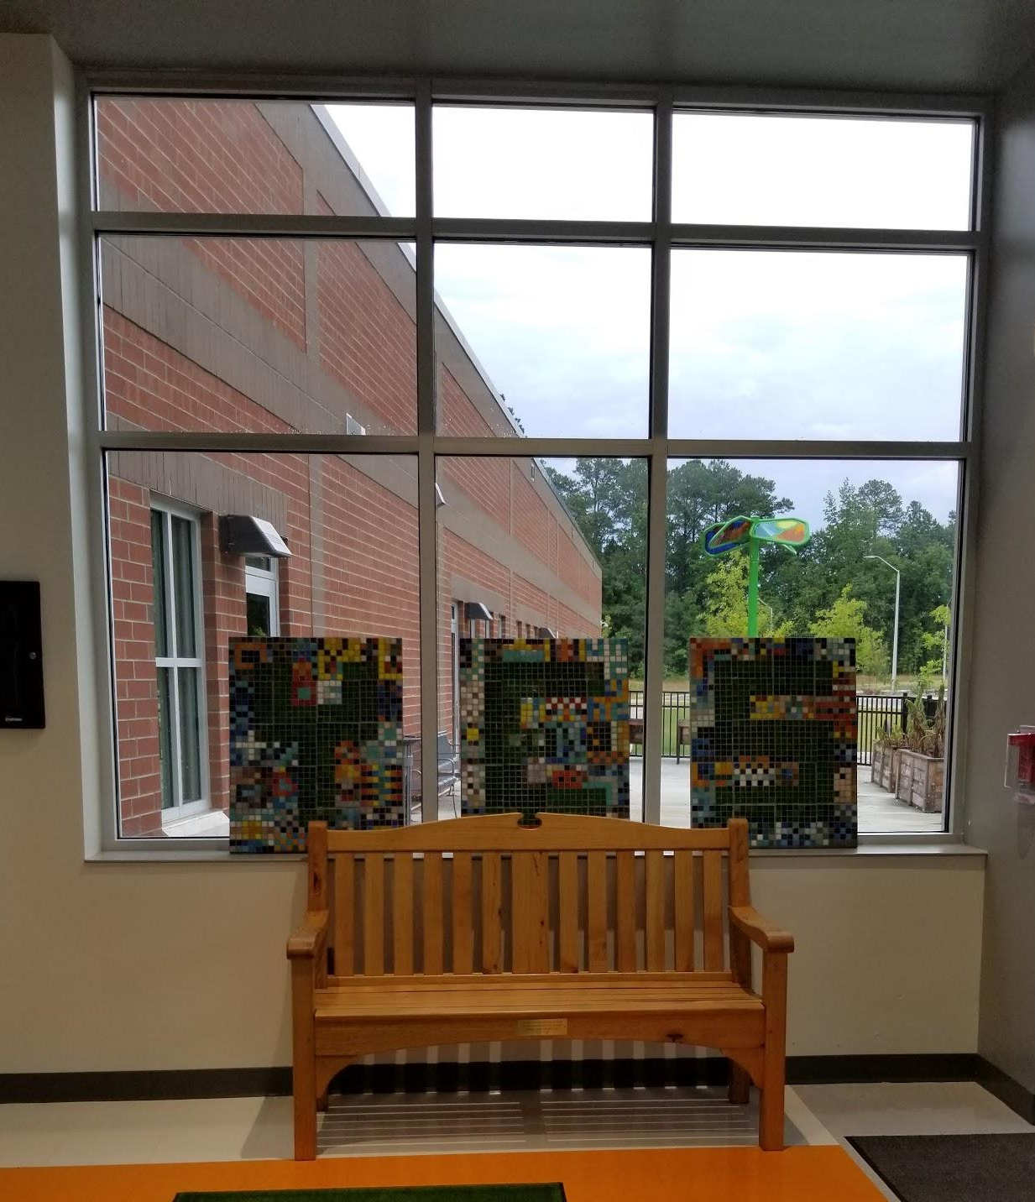
Virtual Tour
Main lobby and front office

Slide 11
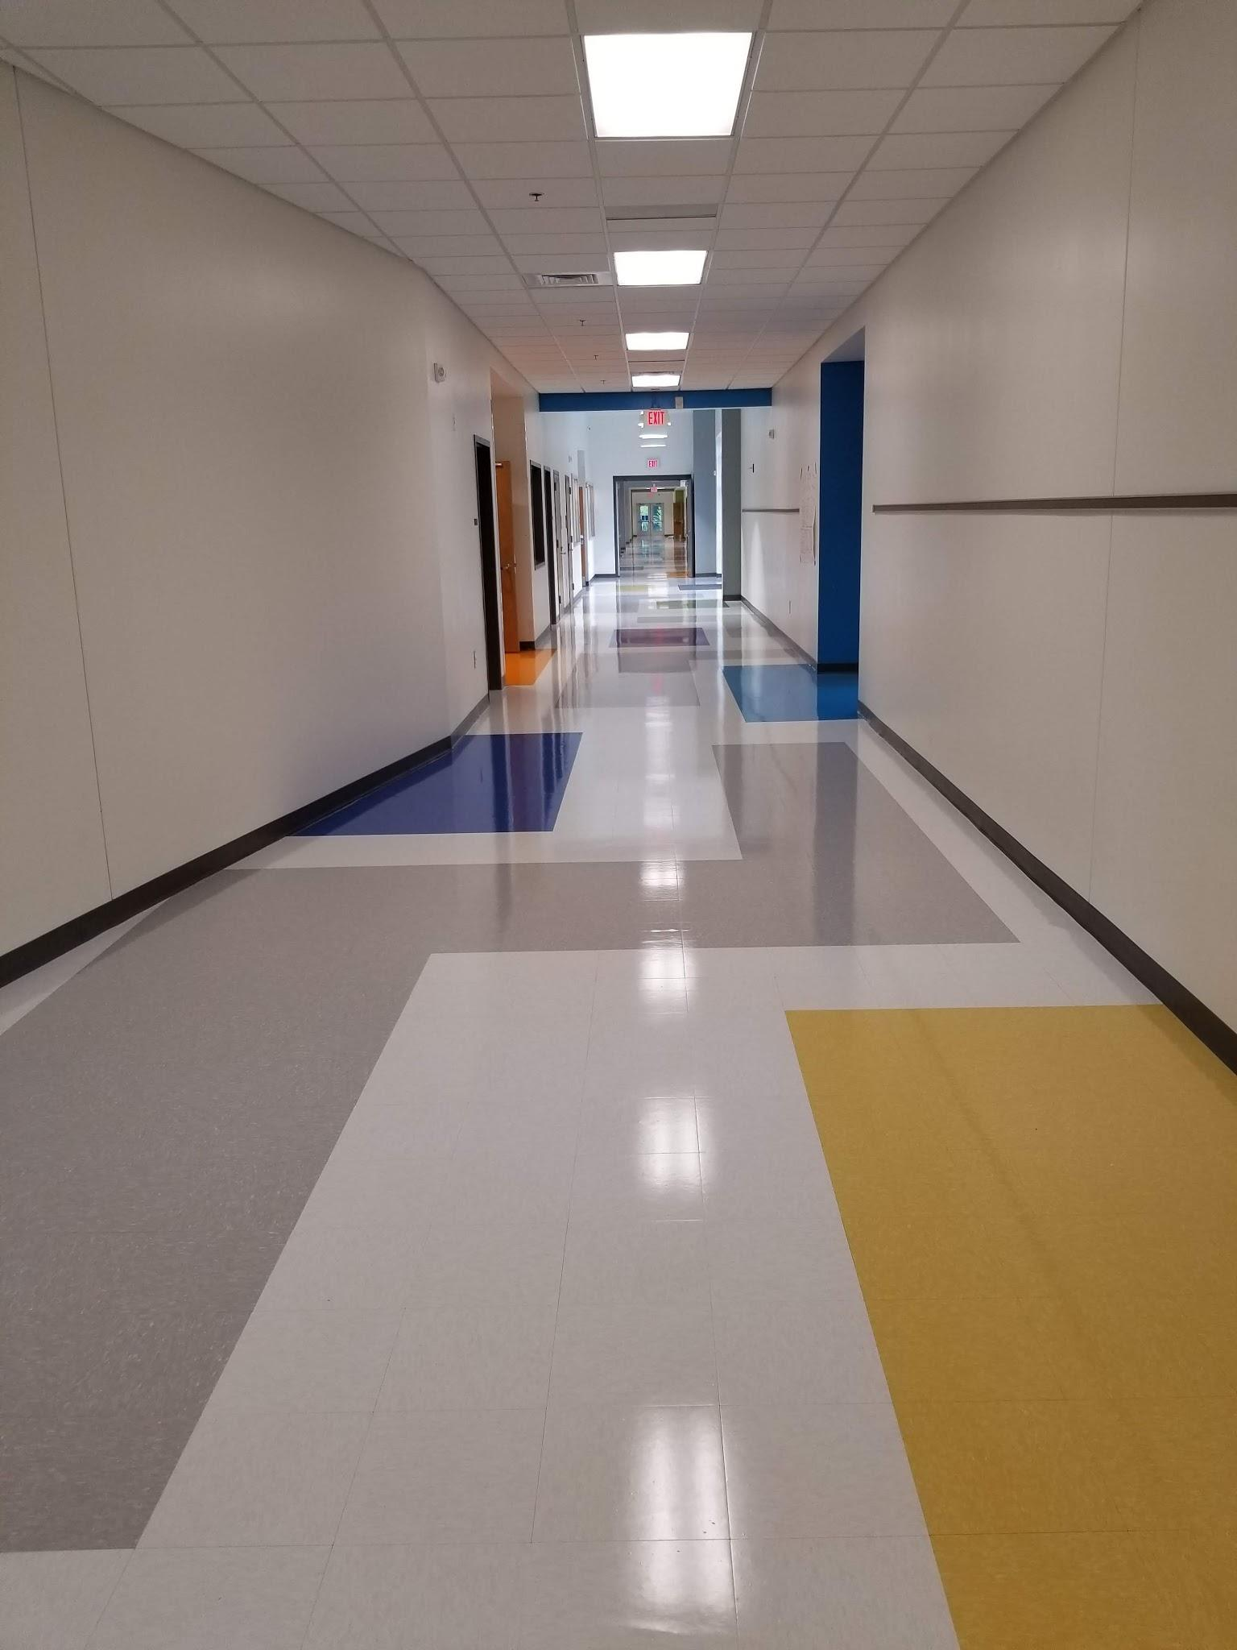
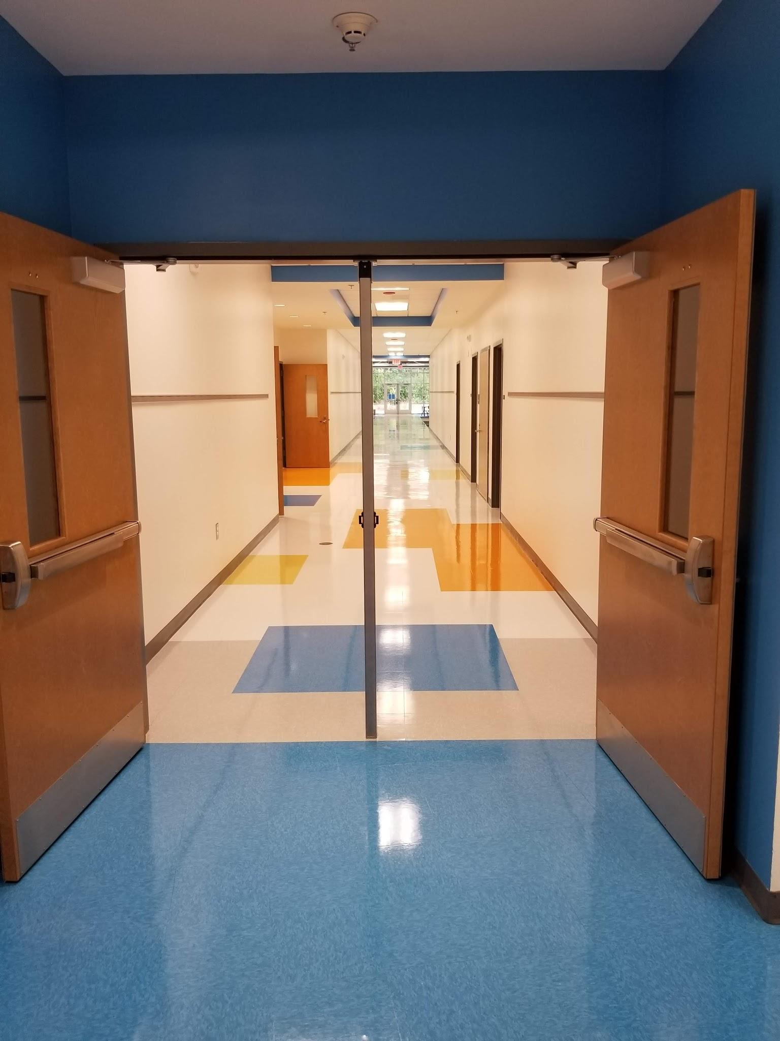
Virtual Tour
Welcome to the Kindergarten/PreK/EC Wing!
Main hallway as students enter. The first right is the Kindergarten hallway - the “BLUE” hallway.

Slide 12
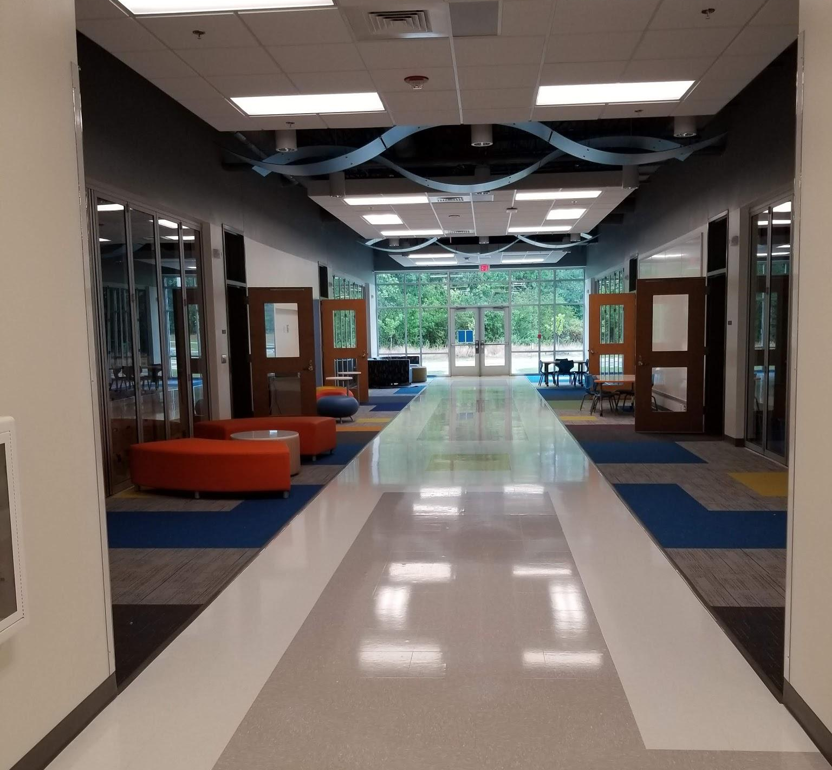
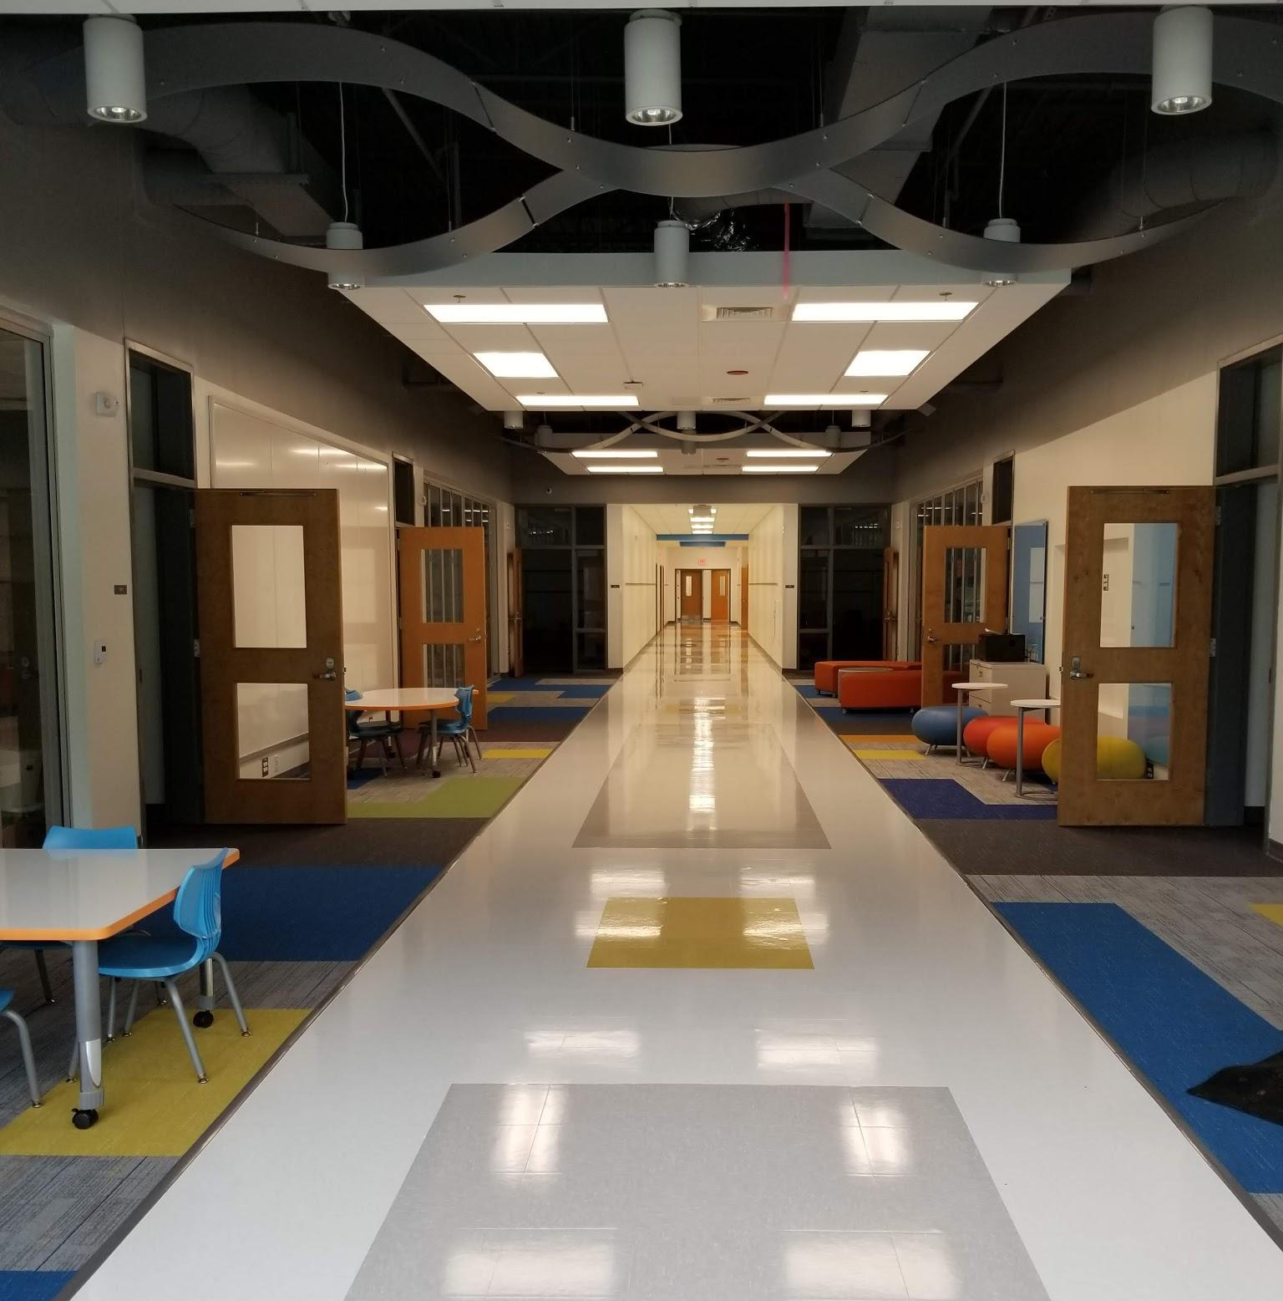
Virtual Tour
4 Kindergarten classrooms open into a large collaborative space. The sliding glass walls are able to open as well.

Slide 13
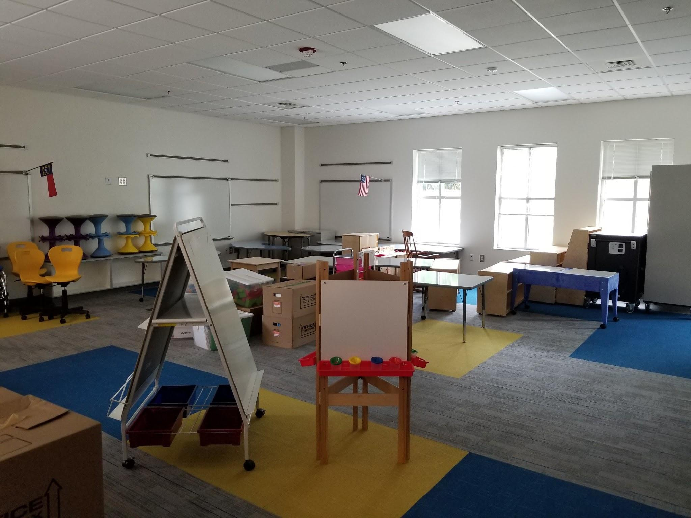
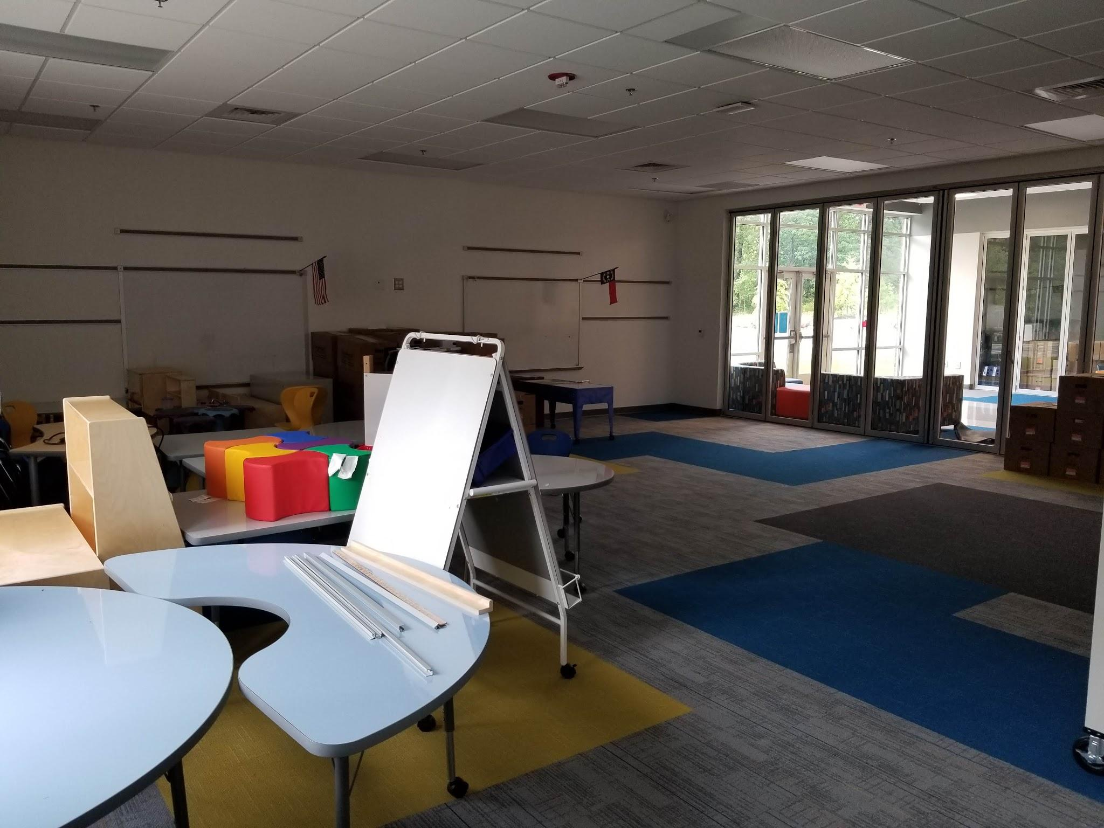
Virtual Tour
Welcome to Kindergarten!
A sneak peak at the classrooms that will get a complete makeover once teachers get in to unpack and work their magic!

Slide 14
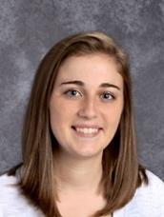
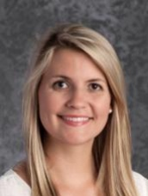
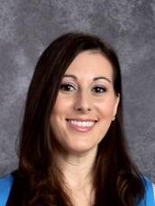
The Kindergarten Teachers
Abby Glembocki – Grade Chair
Danielle Nguyen
Laura Newton
Marisa Chandler

Slide 15
A Day in Kindergarten
Morning Work
Calendar/ Morning Meeting
Writing and Literacy Instruction
Letterland Lesson
Recess
Lunch
Specials
Math
Snack
Science/Social Studies
*May change slightly*

Slide 16
Kindergarten Curriculum
Kindergarten Quick Reference Guide
NC DPI Standard Course of Study
By the end of the year, kindergarten students will be able to:
-Identify all letter names and sounds (upper and lowercase letters).
-Read simple words by "sounding them out". Example: top, sick, dogs, etc.
-Identify high frequency words by sight, that can not be sounded out. Example: the, are, said
-Identify the characters, setting, and events of a story when read to.
-Count to 100 by 1s and 10s.
-Write numbers 0-20.
-Solve addition and subtraction story problems within ten by drawing a picture.

Slide 17
Instructional Benchmarks
Wake County requires that students meet “Kindergarten Benchmarks” in order to be promoted to First Grade.
Your child’s teacher will keep you informed about your child’s progress at conferences and with report cards/progress reports. Progress reports & report cards go home every quarter.
Parent-Teacher conferences are held at the end of 1st quarter and end of 2nd quarter.
(More frequently if desired/needed)

Slide 18
Goals for York K Teachers
To provide a nurturing, safe, environment in which all students learn.
To provide consistent communication to parents/families in reporting student progress, as well as concepts and skills being taught.
To provide opportunities to involve parents/families as active partners in education.

Slide 19
Family Goals
Read to your child every night.
Stay up to date on what your child is learning by reading the weekly newsletter and other communication from the teacher.
Provide support for activities and lessons being taught.
Communicate your needs - email questions or concerns directly to the teacher.

Slide 20
Kindergarten Supply List
All students please bring:
-1 yellow plastic folder
-1 blue plastic folder
-1 pair of kid scissors
-1 composition book
-1 box of Ziplock bags
-Last names A-I: quart -Last names J-R: gallon -Last names S-Z: snack
If you are able to donate to our classroom, we would love:
-non-perishable snacks (goldfish, cheerios, etc)
-baby wipes
-pink block erasers
-tissues
-paper towels

Slide 21
Forms needed...
Please be sure that your child’s NC Health Assessment form and copy of current immunizations are given to our data manager, Patty Kearns, by the 1st day of school.
Any questions?
Call Patty Kearns at school or email her (pkearns@wcpss.net)

Slide 22
Transportation
Bus
Mr. Huber and Mrs. Kearns can help with any bus transportation needs.
thuber@wcpss.net and pkearns@wcpss.net
Carpool
Carpool tags will be distributed when you drop your child off on the first day(s) of school. Just let us know if you need one.
Tags must be displayed at all times while on campus (in the pm) by hanging it from your rearview mirror.

Slide 23
School Nurse
Amy Sutton, MSN, RN-BC
alsutton@wcpss.net 919-524-4915
MEDICATIONS
-Medications will be administered at school ONLY if a Physician Order for Medication form (1702) is completed, signed by physician and parent, and is in the possession of school officials.
-These forms are available at the front office. The Medication form and the pharmacy label information must match.
-ALL medications must be brought to school by parent/guardian.
-ALL medications must be in the original pharmacy container with original label on it.
CHRONIC ILLNESSES
-If your child has a chronic illness such as diabetes, severe asthma, severe allergies or seizures, please contact your school nurse.
-A health care plan may be able to be developed indicating steps to be taken if your child requires medical care at school.
*Continued health guidance will be issued from NCDHHS and WCPSS in regard to staying healthy during this time.
Return-to-Campus Guide for Families

Slide 24
Susannah Wheat - School Counselor
(swwheat@wcpss.net)
919-881-4960 (ext. 26284)
School Counselor’s Role
Advocates for the well-being of ALL students
Supports the social/emotional, academic, and career development of ALL students in collaboration with parents/guardians, educators, and administrators
Contact with students
Teaches classroom counseling lessons (example topics: self-control, identifying and managing feelings)
Facilitates small-groups (example topics: making and keeping friends, anger management)
Provides individual counseling (example topics: divorce, death in family, bullying)
Learn more: YESCounseling.weebly.com
YESCounselingEnEspanol.weebly.com

Slide 25
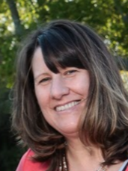
ESL -
English as a Second Language
ESL Teacher -
Lisa Dolezal
ldolezal@wcpss.net
Serving York
Mondays, Wednesdays and every other Friday
Notes:
Lisa

Slide 26
ESL -
English as a Second Language
If your family speaks a language other than English at home, you will be notified by the CIE or by myself to test your Kindergartener on their listening and speaking skills in English.
After given the W-APT (our language proficiency test), your child may qualify for ESL service. At that time, you will hear from me as to your child’s scores and the amount of time they will be served.
Notes:
Lisa

Slide 27
York PTA
PTA Meetings - General Assembly usually 2-3 times/year
PTA Board meets monthly
Member Hub
Join the PTA/Volunteers
School Spiritwear
Check out the PTA page on the school website

Slide 28
Save the Dates!
August 15: Popsicles on the Playground
August 16: Early Assessment Day
August 23-26: Staggered Entry (9 am- 2 pm)
August 23: Last names A-F
August 24: Last names G-L
August 25: Last names M-R
August 26: Last names S-Z
August 27: Meet the Teacher
August 30: First Full Day of Kindergarten!
**More information will be coming about these dates and events as we get updated guidance from WCPSS on protocols for next year.**

Slide 29
Contact Us:
Main Office phone is 919.881.4960. Our receptionist is Mrs. Vlanich. She can direct your questions to the appropriate person.
Ms. Glembocki is the Kindergarten Grade Chair. You can email her questions at aglembocki2@wcpss.net
Our school website is https://www.wcpss.net/yorkes
Follow us on Twitter & Facebook

Slide 30
Contacts con’t:
**Please ensure that we always have your most recent contact information, including your email address and cell phone number.** Contact Patty Kearns at pkearns@wcpss.net with updated information.
We use social media, email, text messages to share critical information with you (classroom newsletters/Principal’s Bulldog Blast).
You can opt-in to text messages by texting YES to the shortcode 67587.
More information is available at wcpss.net/schoolmessenger

Slide 31
Questions?

